Slide 1

Natural Language Processing
Recitation Class

Slide 2

1. Bag Of Words
The "Bag of Words" (BoW) model is a simple and commonly used technique in natural language processing (NLP) for text analysis and feature extraction. It represents a text document as an unordered collection of words, discarding grammar, word order, and structure, and focusing solely on the presence or absence of words.

Slide 3
Steps in BoW
Tokenization
Vocabulary Creation
Vectorization

Slide 4
Key points to note about the BoW model:
It simplifies text data by ignoring word order and structure.
It's a count-based representation, so word frequency information is retained.
It's often used as input for machine learning models like Naive Bayes, Decision Trees, or Support Vector Machines for text classification tasks.
BoW does not capture semantic meaning or word relationships, which can limit its effectiveness for certain NLP tasks.

Slide 5
What is WordNet?
WordNet is like a digital dictionary with superpowers. It's not just a regular dictionary; it's a special tool that helps computers understand words in a more meaningful way. WordNet groups words with similar meanings together, shows how words are related to each other, and even helps figure out different meanings of the same word. It's like a superhero for computers when they're trying to understand and work with words in human language.

Slide 6
Example of WordNet
Word: "Car"
1: "Car" as an Automobile
Synonyms: automobile, motorcar, machine, motor vehicle
Hypernym (more general term): vehicle
Hyponyms (more specific terms): sedan, SUV, truck, convertible, etc.
Part Meronyms (parts of a car): wheel, engine, windshield, etc.

Slide 7
Problems with WordNet
Limited Language Coverage: WordNet provides extensive coverage for English words but may lack comprehensive support for other languages.
Word Sense Ambiguity:The word "bank" can mean a financial institution or the side of a river, depending on context.
Lack of Semantic Nuances: It may not distinguish between the subtle differences in synonyms like "happy" and "joyful."

Slide 8
2 model variant: Sara likes to play tennis
Continuous Bag of Words (CBOW) Model:
In CBOW, the model predicts a target word based on its context (surrounding words).
Example: Given the context ["Sara", "to", "play"], predict the target word "likes."
Skip-Gram Model:
In the Skip-Gram model, the goal is to predict context words given a target word.
Example: Given the target word "likes," predict the context words ["Sara", "to", "play"].

Slide 9
What is Glove?
GloVe, which stands for Global Vectors for Word Representation, is a popular technique in Natural Language Processing (NLP) for word embedding.
It's designed to capture the global statistics of word co-occurrence.
How Does GloVe Work?
GloVe calculates word embeddings by considering the co-occurrence statistics of words in a large text corpus.
The key insight is that the ratio of co-occurrence probabilities for pairs of words is meaningful.

Slide 10
Co-Occurrence Matrix
Rows represent target words.
Columns represent context words.
Cells contain the number of times a target word and a context word co-occur within a specified context window.

Slide 11
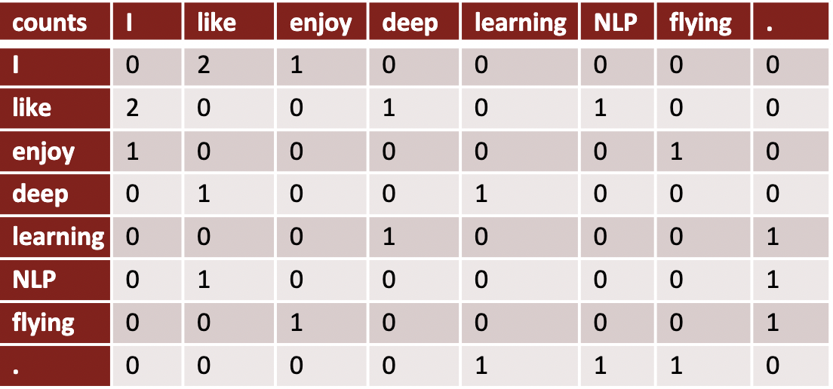
Example of Co-Occurrence matrix
Example corpus: • I like deep learning • I like NLP • I enjoy flying

Slide 12
Advantage of Glove
Captures global word co-occurrence patterns.
Produces meaningful word embeddings.
Useful for various NLP tasks.

Slide 13
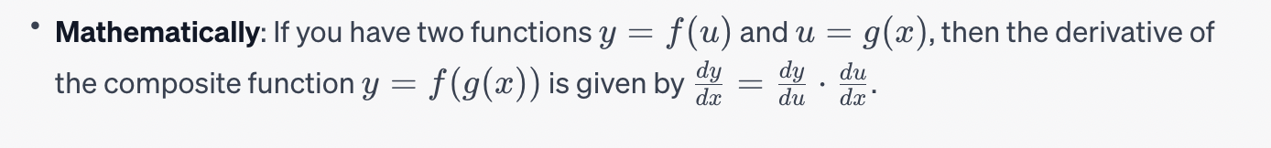
Chain Rule
The chain rule is a fundamental concept in calculus that allows you to find the derivative of a composite function. It states that the derivative of the composition of two functions is the product of the derivative of the outer function and the derivative of the inner function.

Slide 14
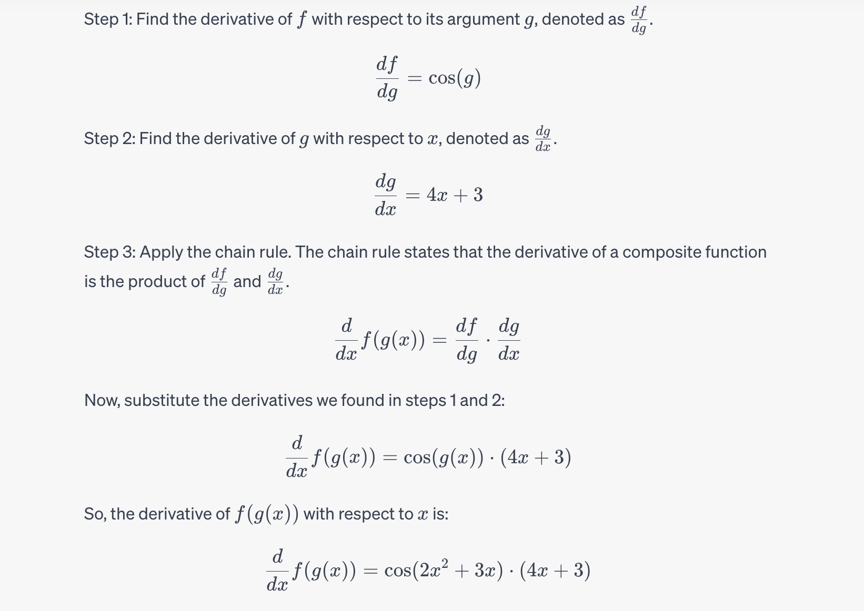
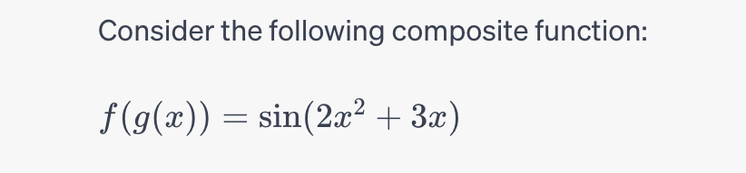

Slide 15
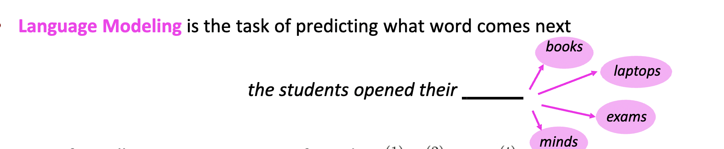
What is Language Model?

Slide 16
Two common types of language models are:
N-Gram Models: These models use statistics based on the occurrence of n-grams (sequences of 'n' consecutive words) to make predictions. For example, a bigram model considers pairs of consecutive words, and a trigram model considers sequences of three words.
Neural Language Models: These models leverage deep learning techniques, such as recurrent neural networks (RNNs) and transformer architectures, to capture complex linguistic patterns and dependencies. They have become particularly popular in recent years due to their ability to handle large vocabularies and long-range dependencies in text.

Slide 17
Issues with N-gram models
Sparsity: Sparse data due to a large number of possible n-grams, making it difficult to estimate accurate probabilities.
Lack of Context: Limited context, as the model only considers a fixed window of 'n' consecutive words.
Out-of-Vocabulary (OOV) Words: Struggles with words not seen during training, assigning them zero probabilities.
Limited Generalization: Doesn't adapt well to diverse language usage or new words/phrases.
Fixed Order: Inflexible to different language structures or grammatical variations.
Inefficiency: Computationally expensive, especially for higher 'n' values.

Slide 18
Improvements over n-gram
• No sparsity problem • Don’t need to store all observed n-grams

Slide 19
Remaining problems:
• Fixed window is too small • Enlarging window enlarges W • Window can never be large enough! • No symmetry in how the inputs are processed.
We need a neural architecture that can process any length of input

Slide 20
RNN
Unlike traditional feedforward neural networks, RNNs have connections that loop back on themselves, allowing them to maintain a hidden state that captures information from previous steps in the sequence
RNN is a type of neural network for sequential data.
It differs from feedforward networks due to its looping connections.
RNNs maintain a hidden state for context from prior steps.
Suited for tasks like natural language processing and speech recognition.
Also used in time series prediction and other sequential tasks.

Slide 21
RNN Advantages:
• Can process any length input • Computation for step t can (in theory) use information from many steps back • Model size doesn’t increase for longer input context • Same weights applied on every timestep, so there is symmetry in how inputs are processed.

Slide 22
RNN Disadvantages:
• Recurrent computation is slow • In practice, difficult to access information from many steps back

Slide 23
Recap
Language Model: A system that predicts the next word
Recurrent Neural Network: A family of neural networks that:
Take sequential input of any length
Apply the same weights on each step.
Can optionally produce output on each step
Problems: Vanishing and exploding gradient
LSTM: Solution of Vanishing gradient
Gradient Clipping: Solution for Exploiding gradient
GRUs are similar to Long Short-Term Memory (LSTM)
Machine Translation
Seq Seq Neural machine translaton

Slide 24

Problems with RNN?

Slide 25
Vanishing Gradient Example:
Suppose you're training a simple neural network for a binary classification task, and you're using a sigmoid activation function. During backpropagation, the gradients start to become very small, close to zero. This means the weight updates are minimal, and the network learns very slowly. For instance:
Gradient of the loss with respect to a weight: 0.0001
Updated weight: 0.5 - 0.0001 = 0.4999
As you can see, the gradient is extremely small, resulting in tiny weight updates. The network converges very slowly, and it may not effectively learn from the data.

Slide 26
Exploding Gradient Example:
Now, consider the opposite scenario where the gradients explode and become very large. During backpropagation, the gradients grow exponentially, leading to massive weight updates. For example:
Gradient of the loss with respect to a weight: 10,000
Updated weight: 0.5 - 10,000 = -9,999.5
In this case, the gradients are so large that they cause dramatic weight updates. The network might oscillate, diverge, or fail to converge to a good solution because the weight updates are too extreme.

Slide 27
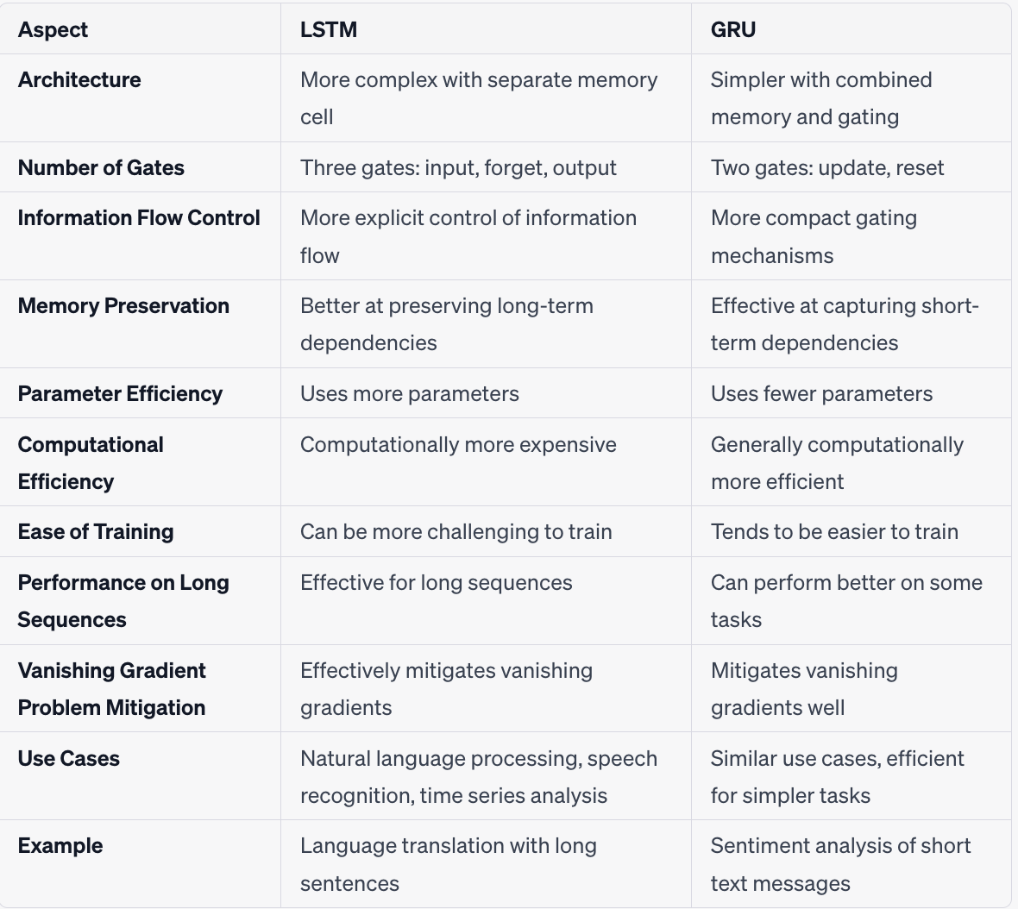

Slide 28
Evaluation of Machine Translation
BLEU (Bilingual Evaluation Understudy) • BLEU compares the machine-written translation to one or several human-written translation(s), and computes a similarity score based on: • n-gram precision (usually for 1, 2, 3 and 4-grams) • Plus a penalty for too-short system translations • BLEU is useful but imperfect • There are many valid ways to translate a sentence • So a good translation can get a poor BLEU score because it has low n-gram overlap with the human translation

Slide 29
So, is Machine Translation solved?
The bottleneck problem arises from the fixed-size representation of the source sentence. If the source sentence is very long or contains complex information, it's challenging for the encoder to compress all the relevant information into this fixed-size vector. As a result, some information may be lost or not adequately represented in the context vector.

Slide 30

Solution to Bottleneck problem?
Attention provides a solution to the bottleneck problem. • Core idea: on each step of the decoder, use direct connection to the encoder to focus on a particular part of the source sequence

Slide 31
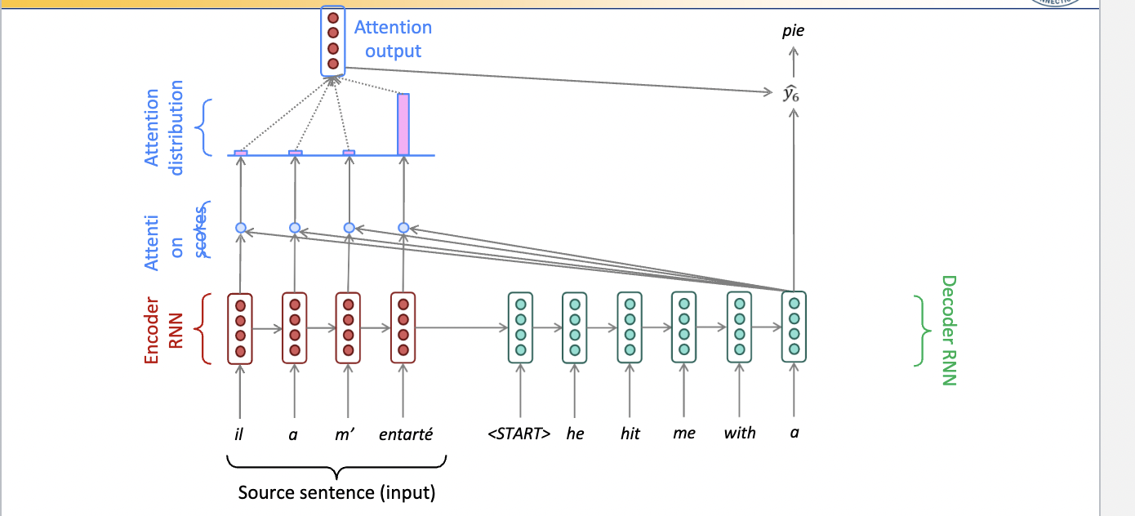
Seq to seq with Attention

Slide 32
Attention benefits:
1. Attention significantly improves NMT performance It’s very useful to allow decoder to focus on certain parts of the source
2. Attention provides more “human-like” model of the MT process You can look back at the source sentence while translating, rather than needing to remember it all
3. Attention solves the bottleneck problem Attention allows decoder to look directly at source; bypass bottleneck
4. Attention helps with the vanishing gradient problem Provides shortcut to faraway states
5. Attention provides some interpretability • By inspecting attention distribution, we see what the decoder was focusing on • We get (soft) alignment for free! • This is cool because we never explicitly trained an alignment system • The network just learned alignment by itself

Slide 33
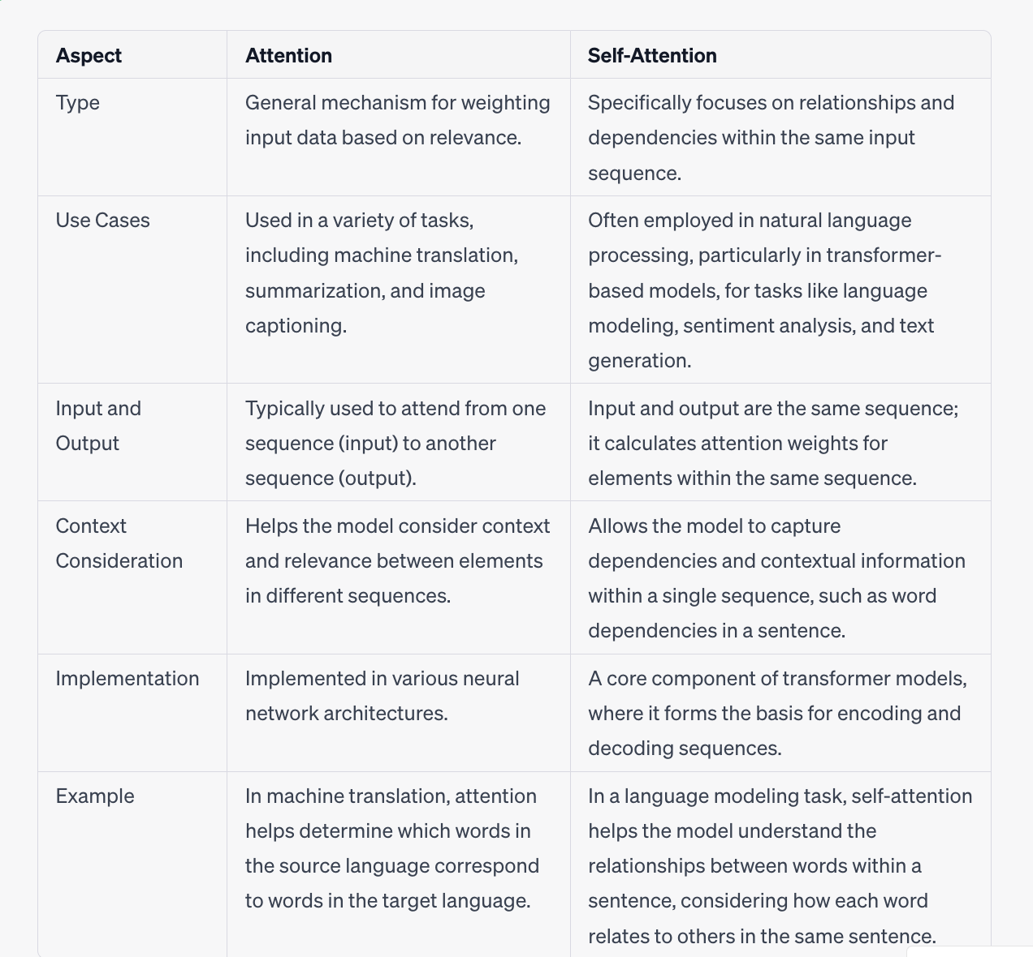

Slide 34
Why Self-attention is important
Self-attention has several benefits that make it important in machine learning and artificial intelligence:
Long-range dependencies: Self-attention allows the model to capture relationships between distant elements in a sequence, enabling it to understand complex patterns and dependencies.
Contextual understanding: By attending to different parts of the input sequence, self-attention helps the model understand the context and assign appropriate weights to each element based on its relevance.
Parallel computation: Self-attention can be computed in parallel for each element in the sequence, making it computationally efficient and scalable for large datasets.

Slide 36
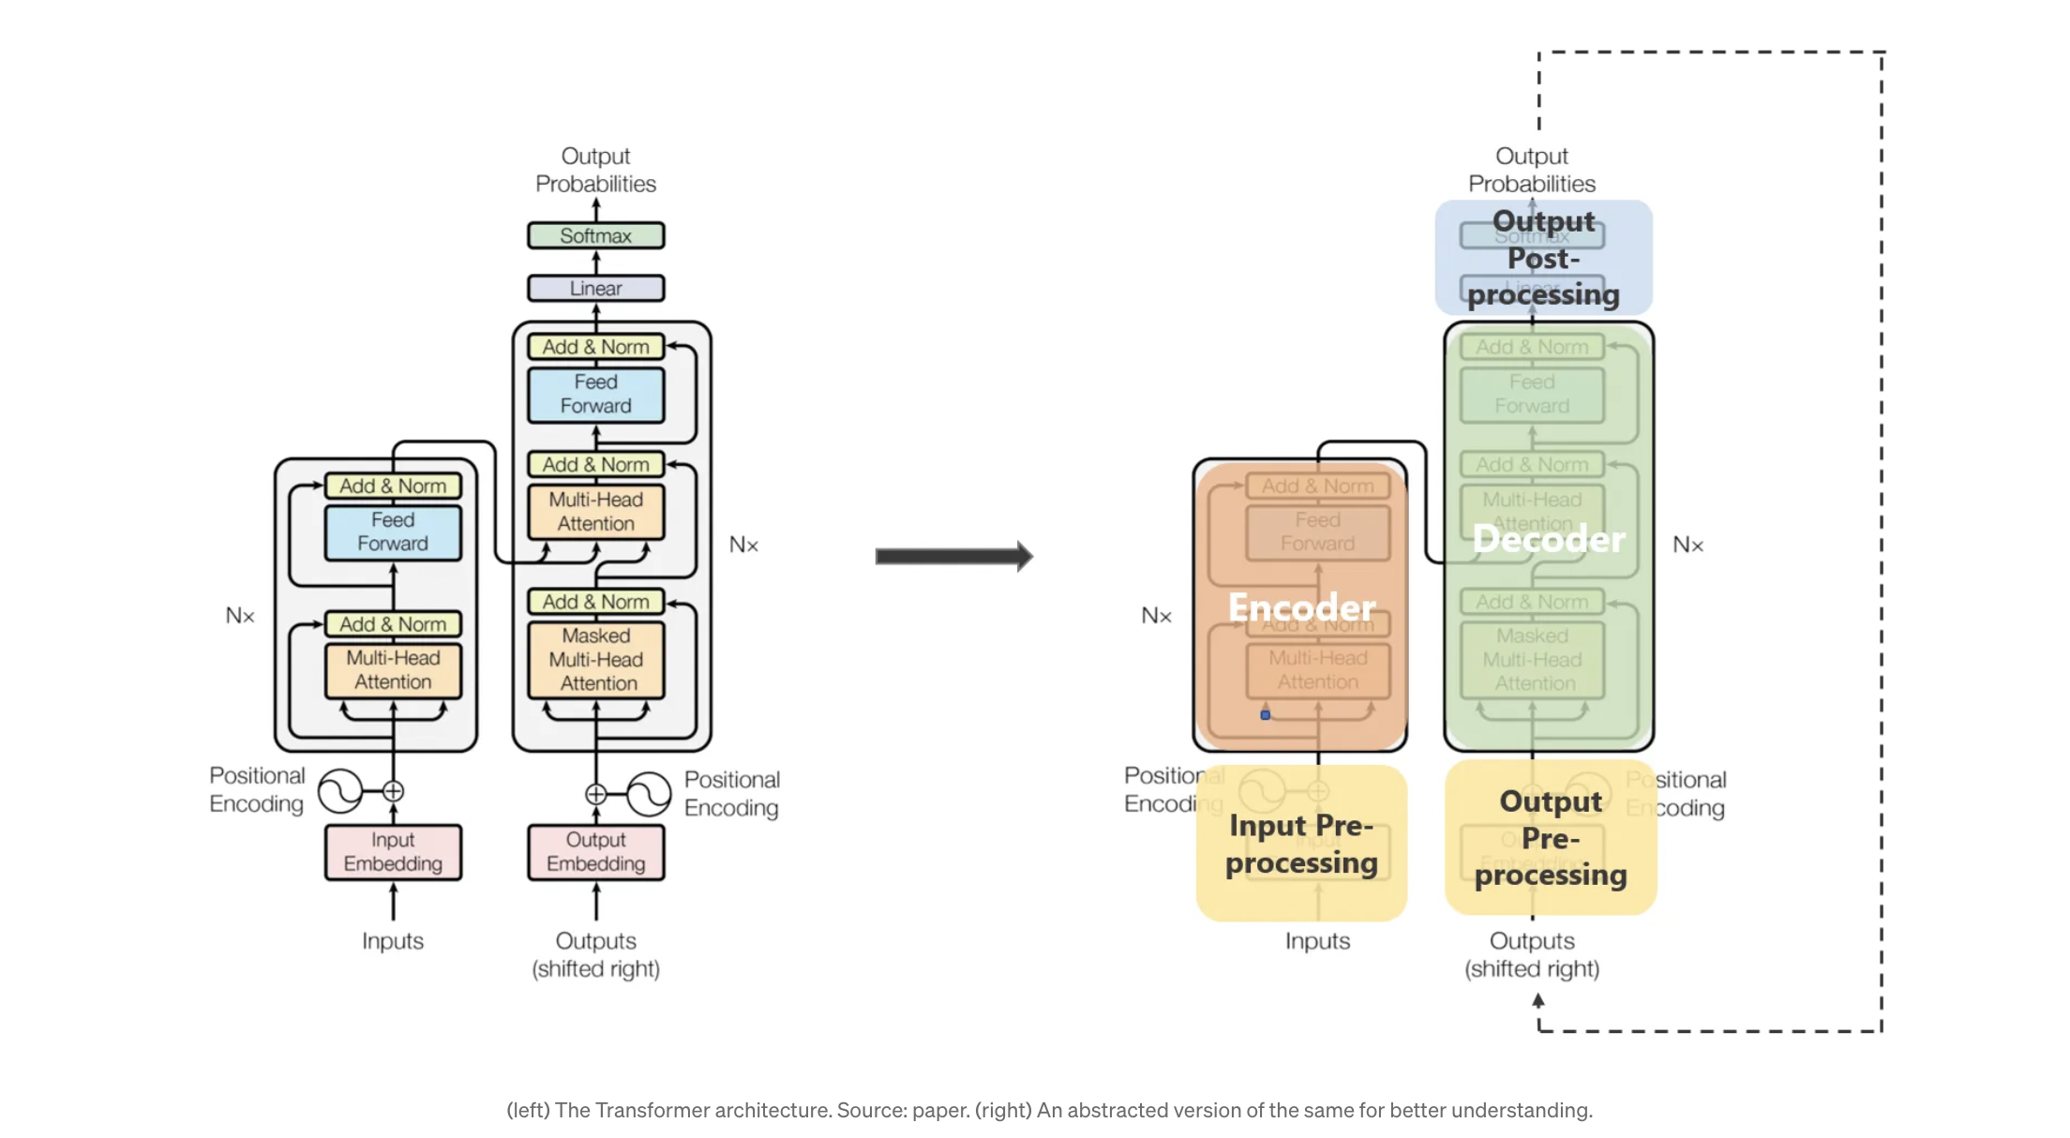

Slide 37
Key components and features of the transformer architecture:
Attention Mechanism:
The attention mechanism allows the model to focus on different parts of the input sequence when making predictions. It captures relationships between words by assigning different weights to different parts of the sequence.
Encoder-Decoder Structure:
The transformer architecture is composed of an encoder and a decoder. In NLP tasks, the encoder processes the input sequence, and the decoder generates the output sequence.
Self-Attention:
Self-attention allows each word in the input sequence to attend to all other words. This enables the model to capture dependencies and relationships between words regardless of their positions in the sequence.
Multi-Head Attention:
To capture different types of relationships and patterns, transformers use multiple attention heads in parallel. Each head focuses on different aspects of the input sequence.
Positional Encoding:
Since transformers don't inherently understand the order of the input sequence, positional encodings are added to provide information about the positions of words in the sequence.

Slide 38
Pretraining
In Natural Language Processing (NLP), pretraining involves training a model on a large corpus of text data to learn general language representations. Pretraining in NLP typically uses unsupervised or self-supervised learning techniques to train models like BERT (Bidirectional Encoder Representations from Transformers), GPT (Generative Pretrained Transformer), and their variants.

Slide 39
Pretraining for three types of architecture
Decoders (Language Models):
Use Cases: Ideal for text generation tasks, but can't condition on future words.
Examples: GPT-2, GPT-3, LaMDA.
Pretraining Focus: Language models like GPT series focus on autoregressive language modeling, predicting the next word based on preceding words, enabling coherent and contextually relevant text generation.

Slide 40
2. Encoders (Bidirectional Context):
Use Cases: Provide bidirectional context, capable of conditioning on future words.
Examples: BERT and its variants like RoBERTa.
Pretraining Approach: Encoders like BERT capture bidirectional context through tasks like masked language modeling, understanding relationships between words in both directions.

Slide 41
3. Encoder-Decoders (Hybrid Approach):
Use Cases: Incorporate the strengths of both encoders and decoders.
Examples: Models like Transformer, T5, Meena.
Pretraining Strategy: These architectures leverage bidirectional context while also enabling text generation and conditioning on future words, aiming to amalgamate the benefits of both encoder and decoder architectures.

Slide 42
Pretraining Process
Encoder Pretraining (Similar to BERT):
Task: Train the encoder to capture bidirectional context and relationships between words in the source sequences.
Method: Utilize a masked language modeling task, similar to BERT.
Example: Given a source sentence, mask certain words and train the encoder to predict the masked words based on the context of the sentence.
Decoder Pretraining (Similar to GPT):
Task: Train the decoder to generate sequences and predict the next word in a sequence based on the preceding context.
Method: Autoregressive language modeling task, similar to GPT.
Example: Given a target sentence, train the decoder to predict the next word in the sequence based on the words preceding it.

Slide 43
"Masked language modeling"
"Masked language modeling" is a technique used in Natural Language Processing (NLP) and is a core component of models like BERT (Bidirectional Encoder Representations from Transformers). In this technique, certain words or tokens in a sentence are randomly replaced with a special token (typically "[MASK]") during training. The model is then tasked with predicting the original word/token based on its context within the sentence.
For instance, in the sentence "The cat is sleeping on the [MASK]," the model might need to predict the masked word. This process helps the model understand contextual relationships between words and sentences, enabling it to learn a rich representation of language that can be used for various downstream NLP tasks like text classification, named entity recognition, question answering, and more.

Slide 44
Question Answering
Question answering (QA) refers to the process of providing accurate and relevant responses to questions posed in natural language. In the context of natural language processing (NLP), QA involves building systems or models that can comprehend human queries and generate appropriate answers based on available information.

Slide 45
Question answering: a taxonomy
Question answering (QA) in the field of natural language processing (NLP) can be understood as a taxonomy, a hierarchical classification, or categorization of various methods, approaches, and techniques utilized to enable machines to comprehend and respond to human questions in a natural language format.
This taxonomy comprises different categories or branches that encompass the diverse strategies and technologies employed in QA systems. It can include:
Question Understanding: System parses, identifies entities, intents, and context of the question.
Information Retrieval: Searches relevant data from datasets or knowledge bases.
Answer Generation: Uses retrieved information to formulate accurate responses.

Slide 46
Techniques for QA in NLP:
Rule-Based Systems: Use predefined rules and linguistic patterns for responses.
Information Retrieval Techniques: Keyword matching, indexing, and search algorithms to find answers.
Machine Learning Models: e.g., BERT, GPT, trained on large text corpora for accurate contextual understanding and response generation.

Slide 47
Here are some aspects: Beyond textual
Multimodal QA: This involves combining different modalities such as text, images, videos, or audio to answer questions. For instance, answering questions about the content of an image or video, or generating textual descriptions from visual inputs.
Interactive QA: Moving beyond static queries to dynamic interactions, where systems engage in conversations or iterative exchanges to gather more context and provide better answers over multiple turns.
Knowledge Graph-based QA: Utilizing structured knowledge graphs or databases to answer questions that require relational or graph-based reasoning. This involves navigating relationships between entities rather than relying solely on textual information.
Scientific and Domain-Specific QA: Addressing QA challenges in specialized domains like medicine, law, or science, where the questions might involve specialized terminologies, concepts, or domain-specific knowledge.

Slide 48
Stanford Question Answering Dataset (SQuAD)
The Stanford Question Answering Dataset (SQuAD) is a widely used benchmark dataset in the field of natural language processing (NLP), specifically designed for testing and evaluating machine reading comprehension and question answering systems.
SQuAD consists of a large collection of real-world reading comprehension passages, extracted from a variety of sources such as Wikipedia articles, along with a set of question-answer pairs created by human annotators.

Slide 49
Key features of SQuAD include:
Realistic Texts: The dataset contains diverse and authentic articles that cover various topics, ensuring a broad range of textual content for comprehension.
Questions and Answers: Each passage in SQuAD is associated with a set of questions that are formulated based on the content of the passage. These questions have corresponding human-generated answers, making them a valuable resource for evaluating the ability of NLP models to understand and answer questions accurately.
Training and Evaluation: SQuAD is commonly used for training and evaluating machine learning models, particularly those focused on reading comprehension and question answering tasks. Researchers and developers use this dataset to assess the performance of their models in understanding context, generating accurate answers, and handling various question types.

Slide 50
Evaluation metrics used in the Stanford Question Answering Dataset (SQuAD)
Evaluation metrics used in the Stanford Question Answering Dataset (SQuAD) are Exact Match (EM) and F1 score, which are common in question answering tasks.
Here's a breakdown of these evaluation metrics in the context of SQuAD:
Exact Match (EM): This metric computes a binary score (0 or 1) to determine if the predicted answer exactly matches the ground truth answer. If the predicted answer precisely matches the reference answer, it receives a score of 1; otherwise, it gets a score of 0. EM is a strict metric that requires an exact match between the predicted and true answers.
F1 Score: The F1 score is a measure of accuracy used in classification tasks. In the context of SQuAD, it's applied to evaluate the performance of question answering models. It considers both precision and recall.
Precision: It is the ratio of the number of shared words between the predicted and true answers to the total number of words in the predicted answer.
Recall: It is the ratio of the number of shared words between the predicted and true answers to the total number of words in the ground truth (true) answer.

Slide 51
Example for EM
Passage: "The cat is sitting on the mat." Ground Truth Answer: "on the mat" Predicted Answer: "on mat"
For EM:
Ground Truth Answer: "on the mat"
Predicted Answer: "on mat"
In EM, an exact match is required between the predicted and ground truth answers.
The predicted answer "on mat" does not exactly match the ground truth answer "on the mat." There's a difference due to the missing space in the predicted answer. Therefore, the EM score is 0 (no exact match).

Slide 52
Example for F1
Precision:
Shared words between predicted and ground truth answer: 2 ("on”, “mat”)
Total words in predicted answer: 2 ("on", "mat")
Precision = Shared words / Total words in predicted answer = 2 / 2 = 1
Recall:
Shared words between predicted and ground truth answer: 2 ("on”, “mat”)
Total words in ground truth answer: 3 ("on", ”the”, "mat")
Recall = Shared words / Total words in ground truth answer = 2/ 3 = 0.67
F1 Score:
F1 Score = 2 * (Precision * Recall) / (Precision + Recall)
F1 Score = 2 * (1 * 0.67) / (1+ 0.67) = 0.80

Slide 53
Other question answering datasets
HotpotQA: It focuses on answering questions that require gathering information from multiple parts of a passage or document. The dataset contains questions that demand reasoning over disjoint pieces of text to arrive at an answer.
TriviaQA: This dataset involves answering trivia questions that require both knowledge and comprehension. It includes both reading comprehension sections and factual questions.
NarrativeQA: It consists of summaries from books and a set of multiple-choice questions designed to test comprehension. The dataset includes a variety of questions, including those that require reasoning over multiple sentences or paragraphs.

Slide 54
BiDAF (Bidirectional Attention Flow)
BiDAF (Bidirectional Attention Flow) is a popular neural network architecture designed for machine comprehension and question answering tasks. It was introduced in a research paper by Minjoon Seo et al. in 2016 and has been influential in the field of natural language processing.
The BiDAF model is based on deep learning techniques and focuses on bidirectional attention mechanisms to better understand and process textual data, particularly for tasks like reading comprehension and question answering.

Slide 55
Here's an overview of the key components and workings of the BiDAF model:
Word Embeddings: BiDAF starts by representing words as dense vectors called embeddings. These embeddings capture semantic and contextual information about words in a continuous vector space.
Character Embeddings: It also utilizes character-level representations to capture morphological information, especially for rare or out-of-vocabulary words.
BiLSTM (Bidirectional Long Short-Term Memory): BiDAF employs a bidirectional LSTM network to model the context from both directions (forward and backward). This allows the model to capture contextual information by processing the input sequence in both forward and backward directions.

Slide 56
Continuation:
4. Attention Mechanism: The key innovation of BiDAF is the attention mechanism, which enables the model to focus on relevant parts of the text when answering questions. It uses attention weights to determine the importance of each word in the context with respect to the question.
5. Modeling Layer: BiDAF combines information from different LSTM layers and attention mechanisms to create a more comprehensive understanding of the text. This modeling layer refines the contextual information obtained from the attention mechanism.
6. Output Layer: Finally, the model produces an output by predicting the start and end positions of the answer span within the given passage. It selects the span of text that is most likely to answer the question.

Slide 57

Thank you.

